Slide 1

Autonomous Vehicle Group
SoECE
Image Segmentation
Using Machine Learning
Students Details:
Under the Guidance of:
Prof. Heera Wali
Sl. No | Name | USN
1. | Nitish D Kulkarni | 01FE20BEC111
2. | Sanjana Bagewadi | 01FE20BEC215
3. | Vijayshankar Warad | 01FE20BEC227
4. | Shweta B Kamatad | 01FE20BEC250

Slide 2
Autonomous Vehicle Group
SoECE
Contents:
Introduction
Need statement
Problem Statement
Why Image segmentation?
Types of Image segmentation
6) Literature survey
7) References

Slide 3
Autonomous Vehicle Group
SoECE
Introduction
Precision and accuracy go hand in hand with Machine Learning.
A popular sub-field of Artificial Intelligence.
Presently ML is being used in each and every sector for its analyzing and predicting power.
It can be applied in E-commerce, Social media, the Automotive industry, Image and speech recognition, the stock market, the medical field, agriculture, weather, sports, and many more.
A vast concept with great potential.
By considering “Image processing/ recognition” which is one of the concepts in the sea of machine learning, we are going to implement the same in the field of image segmentation as a part that is required for self-driving cars.

Slide 4
Autonomous Vehicle Group
SoECE
Need Statement:
Image segmentation plays a vital role in the field of autonomous industry, where it functions just like the eyes to a human being. It helps to extract the object of interest from an image such as vehicles, humans, animals to provide a pictorial representation of the view to the self driving cars. As many computer vision algorithms rely on visual input, blurry images challenge the performance of these algorithms. Image deblurring has thus received considerable attention.

Slide 5
Autonomous Vehicle Group
SoECE
Problem Statement:
A model to identify static and moving objects such as humans, animals, and other vehicles in daylight,clear weather conditions and on a structured road thereby ensuring a hassle-free and smooth ride by autonomous vehicles.

Slide 6
Autonomous Vehicle Group
SoECE
What is Image Segmentation?
It is a method in which digital image is broken down into various subgroups called image segments.
This method helps in reducing the complexity of the image.
Segmentation in easy words is assigning labels to pixels.
All picture elements or pixels belonging to the same category have a common label assigned to them.
Approaches to image segmentation:
Similarity approach: It is based on detecting similarities between image pixels to form a segment.
Discontinuity approach: This approach relies on the discontinuity of pixel intensity values of the image.

Slide 7
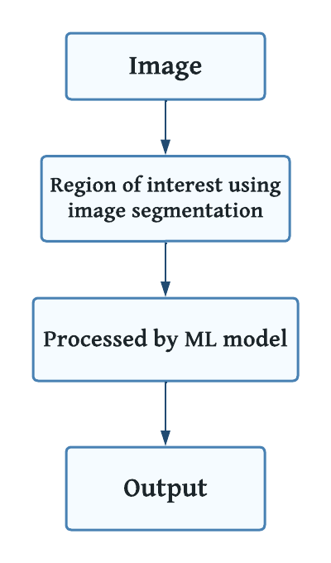
Autonomous Vehicle Group
SoECE
Flowchart:

Slide 8
Autonomous Vehicle Group
SoECE
Importance of Image segmentation:
In these growing years in the field of technology there has been a constant effort in adopting self driving cars.
To detect objects around the autonomous vehicles is essential to drive safely. Instance segmentation is an extension of object detection used to identify the objects in the image.
In order to bring self driving cars which are capable of taking decision on its own according to the situation. This decision making ability matters and plays a very important role.
Image segmentation in autonomous vehicles is an automobile platform capable of sensing and reacting to its immediate environment in an attempt to navigate roadways without human intervention.

Slide 9
Autonomous Vehicle Group
SoECE
Types of Image segmentation:
Semantic Segmentation: It refers to the classification of pixels in an image into one of the classes. Pixels belonging to a particular class are simply classified to that class with no other information or context taken into consideration.
Instance Segmentation: Instance segmentation models classify pixels into categories on the basis of “instances” rather than classes.
Panoptic Segmentation: It is the most recently developed segmentation task, can be expressed as the combination of semantic segmentation and instance segmentation where each instance of an object in the image is segregated and the object’s identity is predicted.

Slide 10
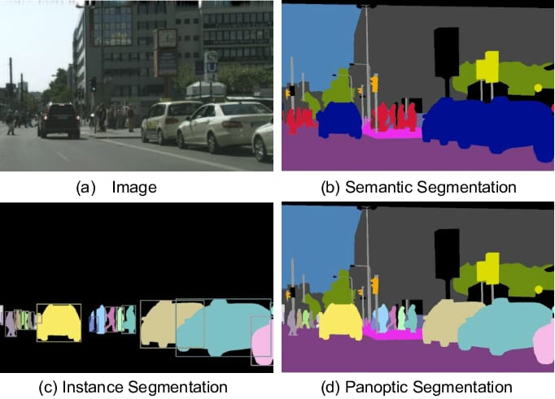
Autonomous Vehicle Group
SoECE
Image source: https://images.app.goo.gl/ZU2sd7TyjY7wkAss7

Slide 11
Autonomous Vehicle Group
SoECE
Identification of multiple solutions and selecting best-suited solution:
There are 3 categories of segmentation to overcome the challenge:
Semantic, panoptic, and instance segmentation.
In semantic segmentation, there is no specific classification for objects, it categorizes group of objects belonging to the same class as a single entity.
But instance segmentation deals with tasks related to countable things. It can detect each object or instance of a class present in an image and assigns it to a different mask or bounding box with a unique identifier.
As in panoptic segmentation it has got both the countable things and uncountable stuff which is not required as per our problem statement.
As per our problem statement the best suited solution is instance segmentation.

Slide 12
Autonomous Vehicle Group
SoECE
Literature Survey: Based on the research papers referred
Sl. No | Title: | Authors: | Summary:
1. | Image blur detection techniques. | Roxanne A. Pagaduan, Ma. Christina R. Aragon and Ruji P. Medina . | Initial process of improving the quality of images that suffers from blur . Most of the images contain two types of regions :blurred and sharp.Blur can be categorized as Defocus blur and Motion blur. Blur detection techniques: Fast Fourier transform: This method calculates the frequencies in the images at different points, based on that frequency it decides whether the image is sharp or blur. Haar wavelet transform: In this method the images are split into NxN by iterating on each tile of 2D and grouping diagonally, vertically or horizontally connected tiles into clusters containing images,are then declared blurred. Laplacian operator: This method discovers edges in a image. Modified Laplacian:This method is developed to compute local measures of the quality of image focus by getting the absolute values of the second derivatives in x and y directions. 5. Tenengrad: This method is based on image gradients obtained by convolving the image with sobel operator that can also be considered as blur measure operator.

Slide 13
Autonomous Vehicle Group
SoECE
Sl. No | Title: | Authors: | Summary:
1. | Region based image segmentation | D. Barbosa ,Group Chen ,Zhen Hua, Yewei Li and Tiancan Mei. | It is a system that joins the edge and locale-based data with an unearthly strategy utilizing Morphological Watershed calculations. Enhanced visual consideration and district developing methodology in which the dim portions and edges of the image are removed utilizing the Gabor channel and Guass-Laplace channels and an artificial neural network is used to extract the interesting region of the image. Supervised image segmentation method, i.e., Region-based Multi-scale segmentation method in which natural scene images are used as a dataset. Image segmentation based on the LEAST SQUARE strategy is a weight grid for an area-based strategy that additionally considers the local data and furthermore the utilization of the Least Square technique gives ideal and quick segmentation.

Slide 14
Autonomous Vehicle Group
SoECE
Sl. No | Title: | Authors: | Summary:
2. | Threshold based image segmentation. | Shiping Zhu, Anping XU, Wu Kaihua & Ban Tau, Frank Jiang | •Threshold based edge detection and image segmentation algorithm. They calculate the threshold of each pixel in the image on the basis of its neighboring pixels and also the edges of image with the help of proposed algorithm. •Threshold-based level set approach comprising both threshold-based segmentation and Fast Marching Method (FMM) for medical image segmentation. The result of the denoising filter is passed to FMM for segmentation purposes with the help of the threshold-based level set technique. •Optimal threshold segmentation method based on entropy criteria and Genetic algorithm in order to improve the image acquisition process in computer vision.

Slide 15
Autonomous Vehicle Group
SoECE
Sl. No | Title: | Authors: | Summary:
3. | Instance Segmentation Technique: A Taxonomy | Abdul Mueed Hafiz & Ghulam Mohiuddin Bhat | RCNN model involves computing class agnostic region proposals obtained using selective search and then model fine-tuning is done which consists of using the region proposals for fine-tuning a pre-trained CNN model like AlexNet. A set of class-specific Support Vector Machine (SVM) classifiers is trained on features extracted from the CNN which replaces the softmax classifier learned by fine-tuning. MultiPath Network technique has been done to the standard Fast R-CNN model.

Slide 16
Autonomous Vehicle Group
SoECE
References:
Sl. No: | Links:
1. | https://www.v7labs.com/blog/instance-segmentation-guide.
2. | https://www.academia.edu/67178485/Image_Segmentation_Techniques_with_Machine_Learning?show_app_store_popup=true
3. | https://nanonets.com/blog/machine-learning-image-processing/
4. | https://analyticsindiamag.com/semantic-vs-instance-vs-panoptic-which-image-segmentation-technique-to-choose/
5. | https://towardsdatascience.com/image-segmentation-part-1-9f3db1ac1c50#161f
6. | https://youtu.be/qej73NGDQfohttps://www.analyticsvidhya.com/blog/2019/07/computer-vision-implementing-mask-r-cnn-image-segmentation/

